Slide 1
Development of a Workplace Violence Prevention Program
Mount Auburn Hospital
Cambridge, MA.
3 April 2019 – Presented by:
Nicholas T. DiIeso, Chief Operating Officer
Heather Gibbons-Perez, Regulatory Compliance and Patient Safety Manager
Andrew Gardner, Director of Quality and Performance Measurement

Slide 2
Overview
Key Components to Developing a Workplace Violence Prevention Program
Summary of Past and Future Initiatives at MAH
Workplace Violence Event Reporting
Achieving an Environment of Healing

Slide 3
Key Components of a Workplace Violence Prevention Program

Slide 4
Executive Leadership Support
Who to Involve
              Active operational role
              Involved in the development of relevant activities (aggressive patient/ Code Gray/ HR/ hostile work environment)
              Credible with peers and other Clinical Groups
For What Function
Integrate Organizational Culture/Norms into Decision Making
      Are aggressive patient/employee behaviors tolerated?
      Hierarchical differences in approach?
      Mean What you Say/Say What you Mean
Mobilize Resources
        Overcome Barriers
        Facilitate Interdisciplinary Buy-In

Slide 5
Develop a Risk Assessment
Components
        Violence Prevention Team
        Administration and Leadership
        Protection Services/Security
        Human Resources
        Employee Orientation and Training
        Relationship with Law Enforcement
        Physical Plant, Interior
        Physical Plant, Exterior
        High Risk Areas (ED, Psychiatry, Newborn, Homecare)
        Data Collection and Reporting
        Post-Violent Incident Procedures
Resources (ECRI, OSHA, Minnesota Department of Health, TJC SEAs (40, 57, 59), QSA (24, 47)

Slide 6
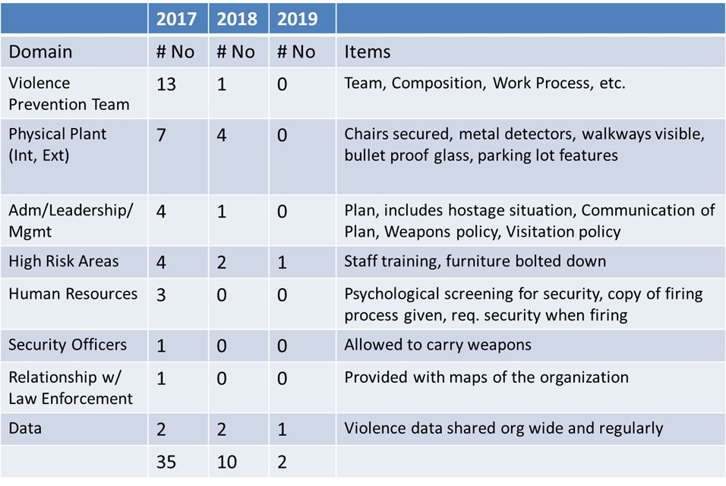
Conduct Annual Interdisciplinary
Risk Assessment

Slide 7
Adopt a Committee Plan
Evaluate Opportunities for Improvement Annually
Identify Action Plans/Committee Objectives
Memorialize in Committee Plan Document
Use Ongoing to Focus Efforts

Slide 8
Conduct Annual Evaluation
What objectives did we meet?
What barriers prevented us from achieving others?
Are they still worth pursuing?

Slide 9
Past and Future Mount Auburn Hospital Initiatives

Slide 10
2017 Initiatives
      Establish Workplace Violence Committee
      Conduct Workplace Violence Assessment/Review all “No” responses to assessment to evaluate for opportunities
      Develop Weapons Policy
      Create workplace violence incident report in rL6, online incident reporting tool
      Create framework for training staff in high risk areas on conflict resolution and crisis intervention, including de-escalation techniques

Slide 11
2018 Initiatives
      Educate on Weapons Policy
      Revise Visitation Policy
      Implement Workplace Violence Incident Report Template in rL6
      Address Workplace Bullying QSA
      Convene Task Force to Address Management of Aggressive Patients
      Communicate to Patients/Visitors that Violence is Not Accepted
      Train High Risk Area Staff on Release/Hold Techniques
      Conduct Risk Assessment for Cash Exchange Areas

Slide 12
2018 Initiatives
      Evaluate Securing Lobby Door during Off-Hours
      Integrate Review of Police Statistics Report into Annual Risk Assessment
      Implement Wand Metal Detector Program in the ED
      Conduct Assessment of Plant Exterior Blind Spots and Conduct Risk Assessment
      Complete Installation of Safety Features to Eliminate Ligature Risks on Wyman 2
      Develop Organization's Workplace Violence Data Sharing Strategy
      Develop/Deploy Workplace Safety Staff Education

Slide 13
2019 Objectives
      Managing Aggressive Patient Behavior
      Staff Training on Release/Hold Techniques
      Make Workplace Violence Staff Education Readily Available
      Extend Support Resources to Reporters of Workplace Violence
      Enhance Workplace Violence Data Integration Strategy
      Develop/Implement Template for Safety Planning/FYI Flag
      Develop Code Gray Education
      Conduct Wyman 2 and ED Safe Room Risk Assessment and Remediation Plan
      Enhance Workplace Violence Incident Reports
      Use Workplace Violence Data to Identify Opportunities for Improvement

Slide 14
Workplace Violence Event Reporting

Slide 15



Safety Event Reporting
Workplace Violence Event Types
Specific Event Type
        Safety/Security
        Employee Event

Slide 16
Safety Event Reporting
Event Classification
        Abuse/Assault (Physical)
        Abuse/Assault (Verbal)
        Threat of Violence
        Disorderly Person
        Aggression Towards Inanimate Object
        Weapons on Premises
        Death Threat
        Intimidation
        Stalking
        Sexual Harassment

Slide 17
Safety Event Reporting
Types of Violence
        Abuse/Assault (Physical)
        Patient on Employee
        Visitor on Employee
        Employee on Employee
        Domestic Violence

Slide 18
Safety Event Reporting
Contributing Factors
        Actions- Caregiver, Family Member, Patient, Staff/Physician, Visitor/Other
        Agitated/Anxious/Combative
        Cognitive Impairment
        Communication Issue
        Confused/Disoriented/Altered Mental Status
        Delirium/Delusions
        Loss of Temper
        Mental Competency
        Substance Abuse/Intoxication
        Teamwork Issue
        Threatening Behavior
        Wait Time

Slide 19
Safety Event Reporting
Immediate Actions
        Apology Made
        Disciplinary Action
        EAP/Peer Support Offered
        Emergency Response Plan Invoked
        Improve Person Protective Device
        Installation of Guard/Safety Device
        No Action
        Referred to Employee Health
        Reinstruction of Staff (Visitor/Other)
        Sent to ED/WIC
        Treatment Provided

Slide 20
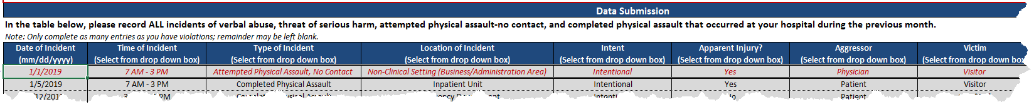
Safety Event Reporting
2019 Enhancements
Preventability Analysis
Mental Status as Contributing Factor Analysis
Crosswalk/ updates for MHA reporting
      Intent (Intentional/ Unintentional)
      Types of Person/Victim (Existed)
      Injury – emotional pain (TBD – case review)
MHA Healthcare Safety and Violence Prevention Survey – March 2019

Slide 21
Achieving an Environment of Healing

Slide 22
Mount Auburn Hospital is committed to providing Excellence with Compassion in every aspect of care it provides to patients and families. To achieve this, there must be an environment of mutual respect and support by staff, patients and families.
We understand that health related events can be stressful.
At times, reactions to these events can result in aggressive
behavior: abusive language, intimidation and/or threats to staff.
These behaviors are NOT acceptable and will be addressed immediately with the individual and the care team. Further behavior of this type will result in intervention by management and may result in restricted access to the facility.

Slide 23
Supporting Staff and Patients to Achieve an Environment of Healing
      Cultural Supports
        Compassionate Care
        Empathetic Listening
        Violence and Aggression is Not Tolerated
      Structural Supports
        De-escalation Training
        Managing Aggressive Patient Behaviors
          Acknowledges Patient Stressors, Clarifies expectations and MAH norms
        Code Gray
        CPI Techniques

Slide 24
Workplace Violence Prevention Program
Resources:
ECRI Institute: Violence in Healthcare Facilities. Healthcare Risk Control, November 2005, Plymouth Meeting, PA. Available online at: www.ecri.org (Accessed January, 2017)
Occupational Safety and Health Administration: Guidelines for Preventing Workplace Violence for Health Care and Social Services Workers. Available online at: https://www.osha.gov/SLTC/workplaceviolence/ (accessed January, 2017)
Minnesota Department of Health (MDH). Preventing Violence in Healthcare: Gap Analysis. http://www.health.state.mn.us/patientsafety/preventionofviolence/ (Accessed January, 2017)
Joint Commission Sentinel Event Alert, Issue 45. Preventing Violence In the Health Care Setting, June 03.2010. https://www.jointcommission.org/sentinel_event_alert_issue_45_preventing_violence_in_the_health_care_setting_/ (Accessed January, 2017)

Slide 25
Workplace Violence Prevention Program
Contacts and Follow Up
Heather Gibbons-Perez
Regulatory Compliance and Patient Safety Manager
Work: 617-499-5665 x 4628
Email: hgibbons@mah.harvard.edu
Andrew Gardner
Director, Quality & Performance Measurement
Work: 617-499-5665 x 1625
Email: agardner@mah.harvard.edu

